Slide 1


Member Report:
July – December 2025
February 2026

Slide 2
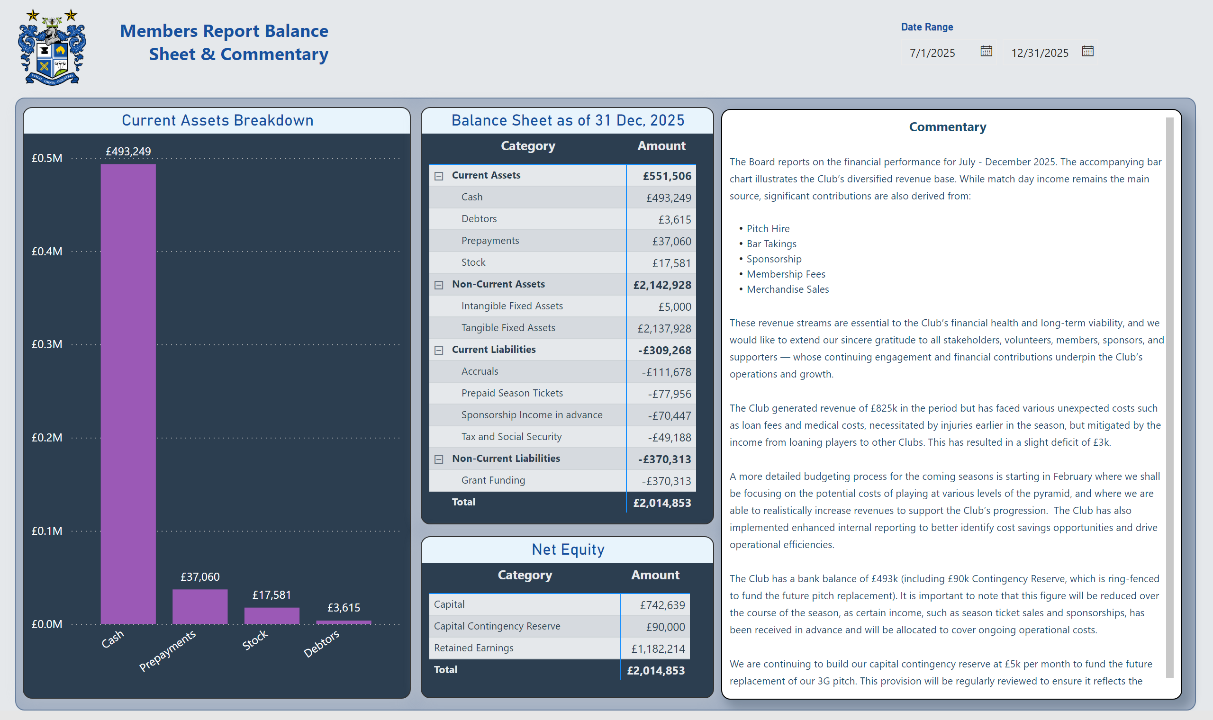
Members Report Balance Sheet & Commentary
Notes:
Date Range
No alt text provided
Current Assets Breakdown
No alt text provided
Balance Sheet as of 31 Dec, 2025
No alt text provided
Net Equity
No alt text provided
textbox
No alt text provided
image
No alt text provided
textbox
No alt text provided
shape
No alt text provided

Slide 3
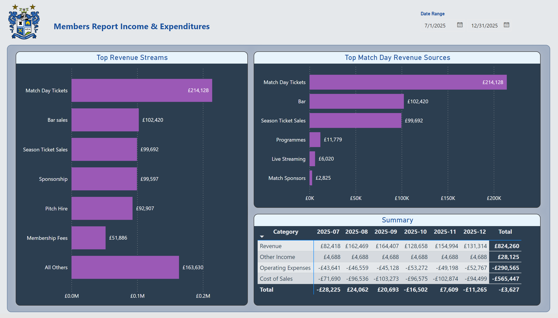
Members Report Income & Expenditures
Notes:
Top Revenue Streams
No alt text provided
image
No alt text provided
textbox
No alt text provided
Date Range
No alt text provided
shape
No alt text provided
Top Match Day Revenue Sources
No alt text provided
Summary
No alt text provided

